Slide 1

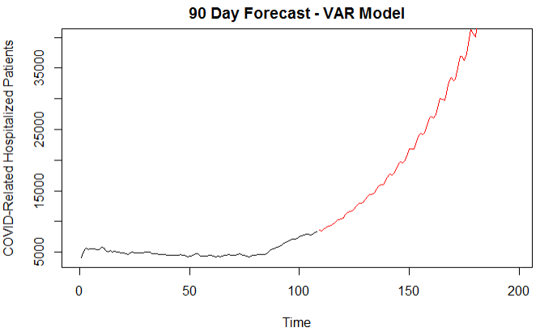

California
VAR Candidate Model
Notes:
Josh Notes: 14 sec
This plot just gives a quick look at why we don't think these models are reasonable for a 90 day forecast. If what is predicted here was true, the number of hospitalized COVID patients would double California’s total hospital capacity in less than two months.

Slide 2

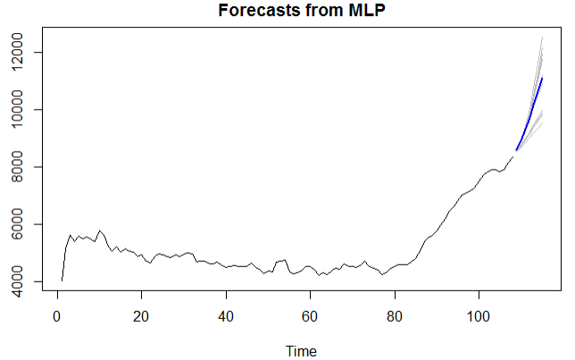
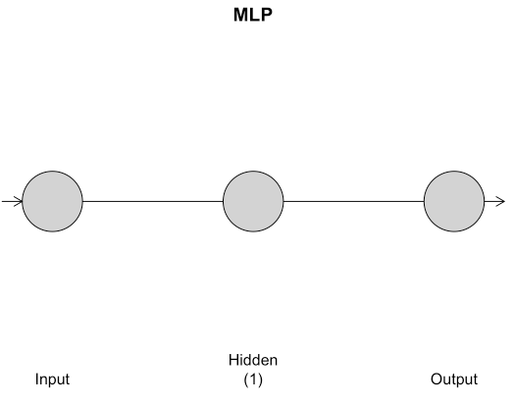

california
Multivariate MLP Candidate Model
7-Day ASE
272,510
Notes:
Josh Notes: 34 sec
The last models examined were built with MLPs that produced an ensemble forecast based on the mean or median of forecasts generated by the MLP. Like with the US data, we ran the MLP with the default settings, then tuned the hyperparameters of the function using rolling-window ASE. The tuned MLP actually returned a single input, single hidden node fit that likely alludes to what we found all the way back in our early exploratory analysis, which was that the best univariate fit for the recent trend was to simply difference the data twice, producing just a straight line. In order to keep the ensemble forecast from being affected by outliers, we used the median predictions in the MLP function.

